Slide 1


Spring Introduction

Slide 2
Content
What is a Framework?
What is Spring Framework?
Spring Framework History
Spring Framework Architecture
Why Spring?
Spring Framework Ecosystem

Slide 3
What is a Framework?

Slide 4

What is a Software Framework?
A set of libraries and classes, which provides built-in generic functionalities, dealt with standard low-level details of a working system.
A reusable software environment.
Can be extended by additional users-written code to provide specific functionalities.
Enforces the adherence to a coding standards and consistent design approaches which are pre-defined by the Framework itself.

Slide 5
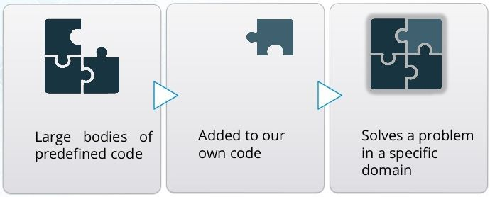
What is a Software Framework?
Each programming language has at least one universal, reusable framework.
Frameworks are fully layered workflow environment. More than just code, they defines the flow of control for the application.
They can includes:
Libraries
APIs
Compilers
Tool sets
Security
Caching
...

Slide 6
Software Framework Advantages
Provides built-in generic functionalities
For example: Security, request handling, caching, logging,...
Reduce overall development effort and time
Developers can focus on writing code just for their specific application requirements
Allows the applications to be implemented in a standard structure
This improves the maintainability of applications

Slide 7
Software Framework Disadvantages
It takes time to learn how to use the framework.
Using a framework increases the size of the program.
Need to follow some coding standards in order to utilize the framework.
It is unsuitable for writing small programs which can be written quickly without using any framework.

Slide 8
What is Spring Framework?

Slide 9
What is Spring Framework?
Open source Java application framework (since 2003)
Supports any kind of Java Applications
Special support for J2EE applications
Foundation: the Core Container
Inversion of Control (IoC) container
Dependency Injection pattern
Spring handles the infrastructure, so you can focus on your application.

Slide 10
Spring Framework History

Slide 11
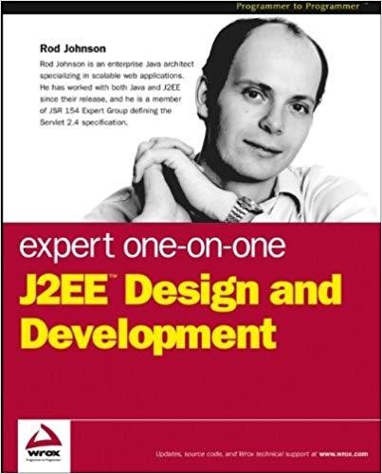
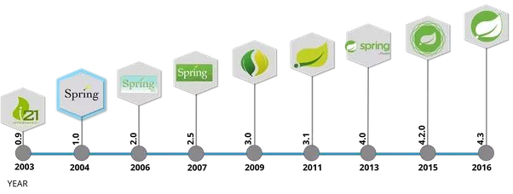
Spring History
In October 2002, Rod Johnson wrote his famous book.
First release in June 2003 (Interface21) under Apache license
First milestone release Spring 1.0 in 2014
Spring 2.0
Simplified XML configuration
Spring 2.5
Annotation configuration
Spring 3.0
Support for Java 7
Servlet 3.0 specs
Java Configuration
Spring 4.0
Support Java 8
Spring 5.0 → 2017
Featuring a new reactive web framework

Slide 12

Spring History
Spring Boot → 2014
Makes it particularly easy to create and config a Spring application.
Automatically configure Spring and 3rd party libraries whenever possible.
Spring Boot hide so much of what going on under the hood.
Spring Boot is still Spring under the hood, it bases on the same core
of Spring.

Slide 13
Spring Framework Architecture

Slide 14
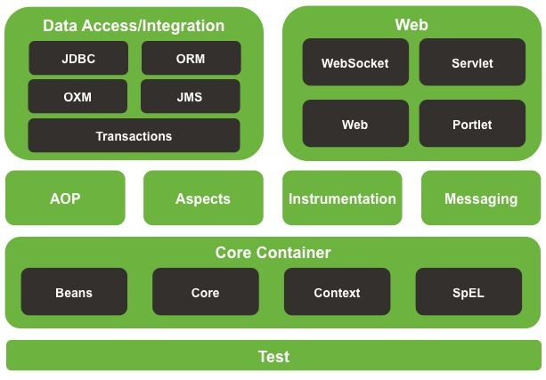
Spring Framework Architecture
Spring Framework consists of features organized into about 20 modules.
These modules are generalized into following layers:
Core Container
Data Access/ Integration
Web
AOP (Aspect Oriented Programming)
Instrumentation
Test

Slide 15
Core Container
Core and Beans modules
Provide the fundamental parts of the framework, including the IoC and Dependency Injection features.
The Bean module provides BeanFactory, which is a sophisticated implementation of the factory pattern.
Removes the need for programmatic singletons
Allows to decouple the configuration and specification of dependencies from your actual program logic.

Slide 16
Core Container
Context module
Builds on the solid base provided by the Core and Beans modules.
It is a medium to access any objects defined and configured.
The ApplicationContext interface is the focal point of the Context module.

Slide 17
Core Container
SpEL (Expression Language) module
Provides a powerful expression language for querying and manipulating an object graph at runtime.
Supports setting and getting property values, method invocation, logical and arithmetic operators, named variables, and retrieval of objects by name from Spring’s IoC container, etc...

Slide 18
Data Access/Integration
JDBC module provides a JDBC-abstraction layer that removes the need to do tedious JDBC coding.
ORM module provides integration layers for popular object-relational mapping APIs, including JPA, JDO, and Hibernate.
OXM module provides an abstraction layer that supports Object/XML mapping implementations for JAXB, Castor, XMLBeans, JiBX and XStream.
JMS (Java Messaging Service) module contains features for producing and consuming messages.
Transaction module supports programmatic and declarative transaction management for classes that implement special interfaces and for all your POJOs.

Slide 19
Web
Web module provides basic web-oriented integration features and the initialization of the IoC container using servlet listeners and a web application context.
Servlet module contains Spring MVC implementation for web applications.
Web-Socket module provides support for WebSocket-based, 2-way communication between the client and the server in web applications.
Web-Portlet module provides the MVC implementation to be used in a portlet environment.

Slide 20
Miscellaneous
AOP module provides an aspect-oriented programming implementation allowing you to cleanly decouple code that implements functionality that should be separated.
Aspects module provides integration with AspectJ (a powerful AOP framework).
Instrumentation module provides class instrumentation support and class loader implementations.
Messaging module provides support for STOMP as the WebSocket sub-protocol.
Test module supports the unit testing and integration testing of Spring components with JUnit or TestNG.

Slide 21
Why Spring?

Slide 22
Why Spring?
These 3 are basically the main reasons for Spring’s popularity:
Simplicity
Testability
Loose Coupling

Slide 23
Simplicity
Spring Framework is simple because its non-invasive as it uses POJO and POJI models.
POJO (Plain Old Java Objects): A Java class not coupled with any technology or any framework is called POJO.
POJI (Plain Old Java Interfaces): A Java interface not coupled with any technology or any framework is called POJI.

Slide 24
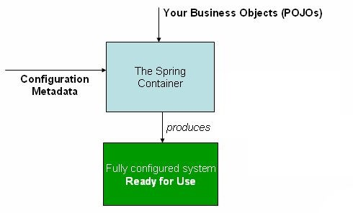
Testability
Actually for writing the Spring application, server (Container) is not mandatory because it has it own container to run the applications.

Slide 25
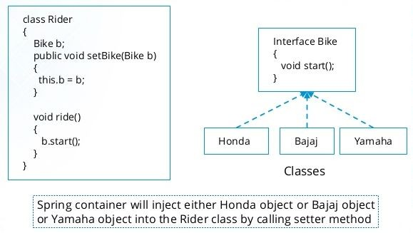
Loose Coupling
Spring Framework is loosely coupled because it has concepts like Dependency Injection, AOP etc.
These features help in reducing dependency and increasing the modularity within the code.

Slide 26
Spring Framework Ecosystem

Slide 27
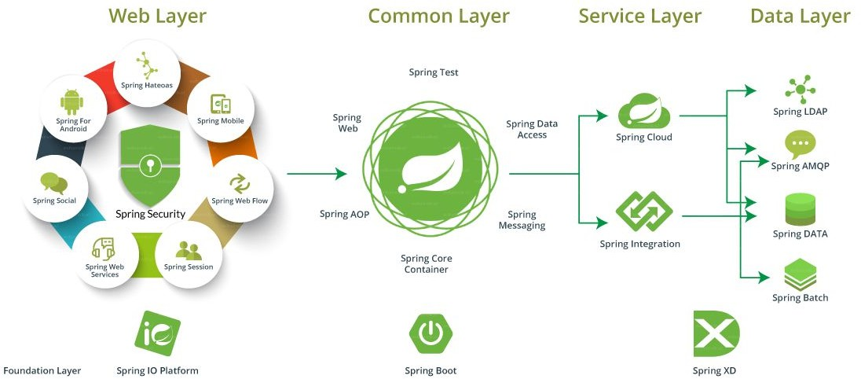

Slide 28
Summary

